Slide 1
Adaptive Neural Architectures for Cross-Domain Object Detection in Changing Environments

Slide 2
Team Details
Ramanjaneyulu Saladi 700751945
Jethin Sai Chilukuri 700746555
Sangam Sai Prakash Reddy 700767044
Rajakala Jaidi 700744420

Slide 3
Role and Contribution in project
Ramanjaneyulu Saladi -
Role: Responsible for gathering relevant data and annotating it for training purposes.
Contribution:
Collected datasets suitable for object detection tasks.
Annotated images with bounding boxes or other appropriate labels.
Ensured data quality and consistency throughout the dataset.
Jethin Sai Chilukuri
Role: Enhance the dataset through augmentation techniques and preparing it for model training.
Contribution:
Implemented data augmentation techniques such as rotation, scaling, flipping, etc., to increase dataset diversity.
Conducted preprocessing tasks such as normalization, resizing, and cropping to standardize input data.
Ensured that augmented data maintains label integrity and relevance.
Optimized data pipeline for efficient training and evaluation.

Slide 4
Role and Contribution in project
Sangam Sai Prakash Reddy
Role: Designing the architecture based on the VGG model and train it on the prepared dataset.
Contribution:
Adapted the VGG architecture for object detection by adding additional layers for detection.
Implemented transfer learning by initializing weights from pre-trained VGG models.
Documented the training process and experiments for reproducibility.
Rajakala Jaidi
Role: Evaluation of the trained model's performance and optimizes it for better results.
Contribution:
Conducted comprehensive evaluation metrics to assess model performance.
Identified areas of improvement based on evaluation results.
Fine-tuned model parameters or explores alternative architectures to enhance performance.

Slide 5
Motivation
Real-World Adaptation: Addressing challenges in object detection across changing environments for practical applications.
Dynamic Adjustment: Developing adaptive neural architectures for robust performance in varied domains.
Generalization Improvement: Enhancing model generalization across diverse environmental conditions.
Resource Optimization: Dynamically allocating computational resources for efficient processing.
Continuous Learning: Enabling models to evolve and adapt to evolving environments without extensive retraining.
Annotation Reduction: Minimizing annotation burden through self-supervised or weakly-supervised techniques.
Transfer Learning Facilitation: Supporting seamless transfer of knowledge from related domains for efficient learning.
Autonomous Systems Empowerment: Contributing to the development of adaptable and reliable autonomous systems for safer operations.

Slide 6
Objectives
Development of Adaptive Neural Architectures: The project aims to design novel neural network architectures equipped with adaptive mechanisms to enhance object detection performance in changing environments.
Addressing Domain Shift: One of the primary objectives is to develop techniques for mitigating domain shift effects, enabling object detection models to generalize effectively across diverse datasets and deployment environments.
Continual Learning Framework: Implementing a continual learning framework to enable object detection systems to incrementally update their knowledge while preserving past experiences, thus facilitating adaptation to evolving conditions without catastrophic forgetting.
Real-time Adaptation: Designing lightweight architectures and online learning algorithms to enable real-time adaptation of object detection models in dynamic environments, ensuring prompt and efficient responses to changing conditions.
Robustness to Environmental Variations: Investigating methods for enhancing the robustness of object detection systems to variations in lighting, weather, background clutter, and object occlusions commonly encountered in real-world scenarios.
Experimental Validation: Conducting extensive experiments and evaluations to validate the effectiveness and performance of the proposed adaptive neural architectures across diverse datasets and application domains.
Practical Applications: Demonstrating the practical applicability of adaptive object detection systems in real-world scenarios, such as autonomous driving, surveillance, and robotics, to showcase their potential impact and utility in critical applications.

Slide 7
Related work
Dynamic Graph Convolutional Networks for Object Detection: Wang et al. proposed dynamic graph convolutional networks for object detection. They introduced a dynamic graph convolutional layer that adapts the graph structure for each input image, allowing for better feature extraction and localization.
Rethinking Pre-training and Self-training: Zhang et al. presented a method that rethinks pre-training and self-training for object detection. They proposed a framework that combines pre-training on large-scale datasets with self-training on unlabeled data, resulting in improved object detection performance in changing environments.
Dynamic Adaptive Feature Selection for Object Detection: Ding et al. developed a method for dynamic adaptive feature selection in object detection. Their approach dynamically selects informative features based on the input data, allowing for better discrimination between objects and backgrounds in changing environments.
Relation Networks for Object Detection: Hu et al. introduced relation networks for object detection. They proposed a novel architecture that models the relations between objects in a scene, leading to improved object detection performance in cluttered environments.

Slide 8
Related work
Universal Object Detection by Domain Attention: Wang et al. introduced a method towards universal object detection by domain attention. They proposed a domain attention mechanism that adaptively focuses on relevant domains during training, leading to improved generalization across diverse environments.
An Empirical Study on Evaluation Metrics of Object Detection Methods: Xiao et al. conducted an empirical study on evaluation metrics of object detection methods. They analyzed the performance of various evaluation metrics under different environmental conditions, providing insights into the robustness of object detection algorithms.
SOLO: Segmenting Objects by Locations: Wang et al. proposed SOLO, a method for segmenting objects by locations. They introduced a novel approach that segments objects based on their spatial locations, enabling more accurate object detection in complex scenes.

Slide 9
Problem Statement
The core challenge this survey addresses is the notable disparity in the adaptability and robustness of object detection models under cross-domain applications and varying environmental conditions. Despite considerable progress in the field, existing models frequently falter when subjected to diverse operational contexts, underscoring a pivotal gap in current technology. This survey aims to thoroughly examine the latest research on adaptive neural network architectures, domain adaptation techniques, and object detection methodologies.

Slide 10
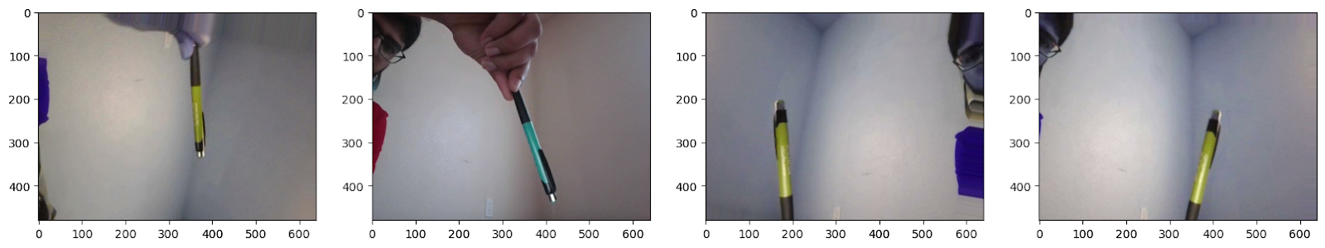
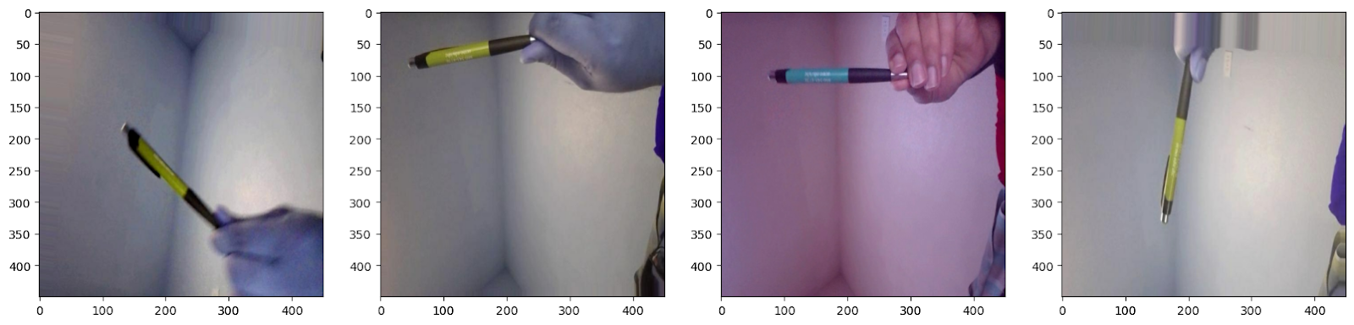
Proposed Solution
Data Collection
Data Annotation
Data Augmentation
Data Splitting
Fig: Sample from Data Collection
Model Building
Model Training
Model Evaluation
Fig: proposed Framework
Fig: Result of Data Augmentation

Slide 11
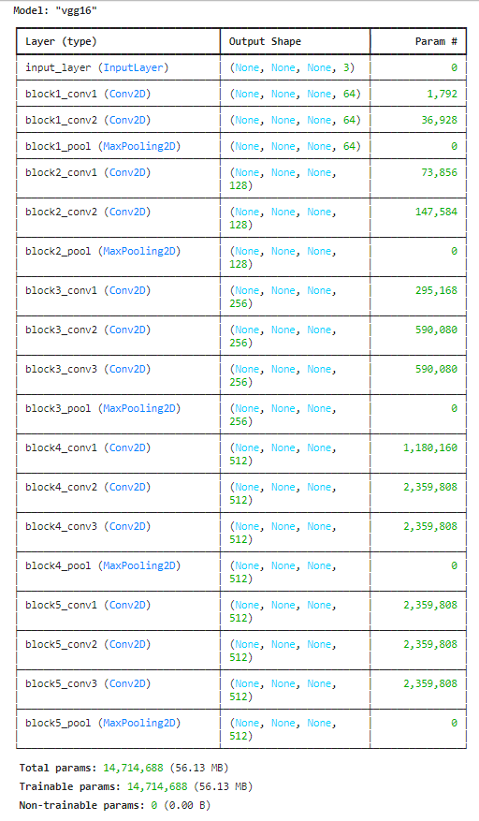
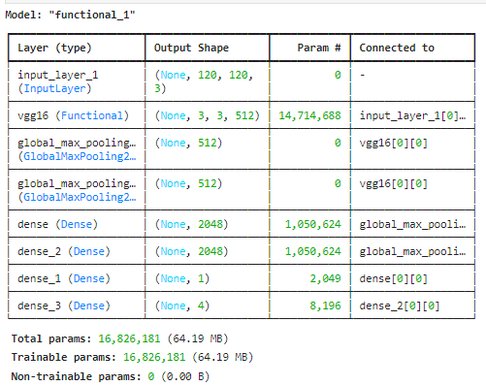
Proposed Solution
Fig: Instance of our Network

Slide 12
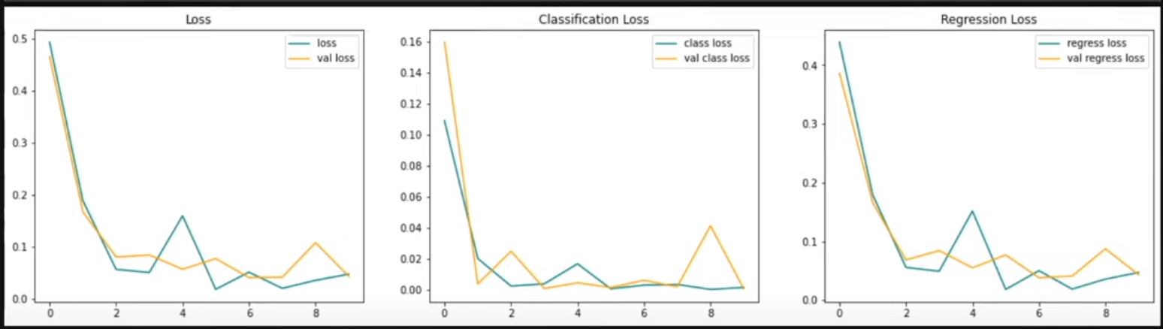
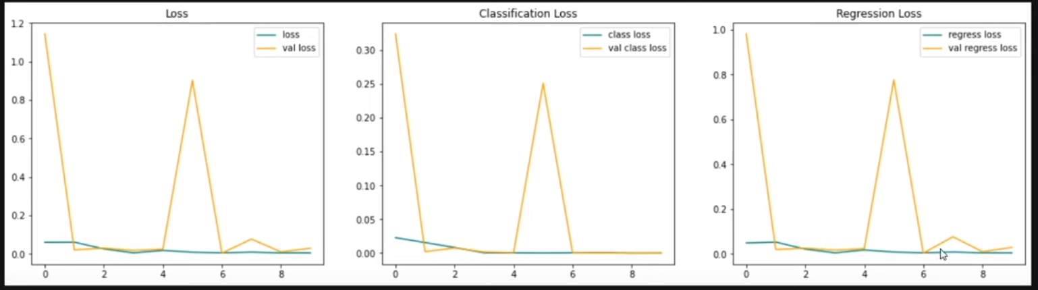
Results
Fig: Model history with changed input parameters

Slide 13
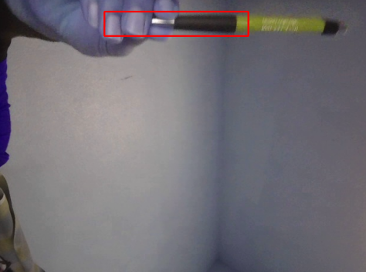
Results
Fig: Predicting the Object

Slide 14
References
Tan, M., Pang, R., & Le, Q. V. (2019). MnasNet: Platform-aware neural architecture search for mobile. arXiv preprint arXiv:1807.11626.
Zhu, Z., Huang, Z., Han, C., & Zhuang, Y. (2019). Joint feature selection and classification with a unified sparse model for object detection. IEEE Transactions on Pattern Analysis and Machine Intelligence, 42(3), 547-561.
Law, H., & Deng, J. (2021). Cornernet: Detecting objects as paired keypoints. In Proceedings of the European Conference on Computer Vision (pp. 734-750).
Wang, Q., Zhang, L., Bertinetto, L., Hu, Y., Torr, P. H., & Kumar, M. P. (2020). Learning to learn from noisy labelled data. In Proceedings of the IEEE Conference on Computer Vision and Pattern Recognition (pp. 12249-12258).
Jiang, J., Ma, Z., Yu, D., Peng, Y., Yu, Y., & Ding, X. (2019). DetNAS: Backbone search for object detection. arXiv preprint arXiv:1903.10979.
Jiang, B., Luo, R., Mao, J., Xiao, T., Jiang, Y., & Zhang, Y. (2020). Acquisition of localization confidence for accurate object detection. arXiv preprint arXiv:1807.11590.
Zheng, Z., Zheng, L., & Yang, Y. (2019). Revisit efficient object detection: From bottom-up to top-down. In Proceedings of the IEEE Conference on Computer Vision and Pattern Recognition (pp. 7108-7116).

